Slide 1
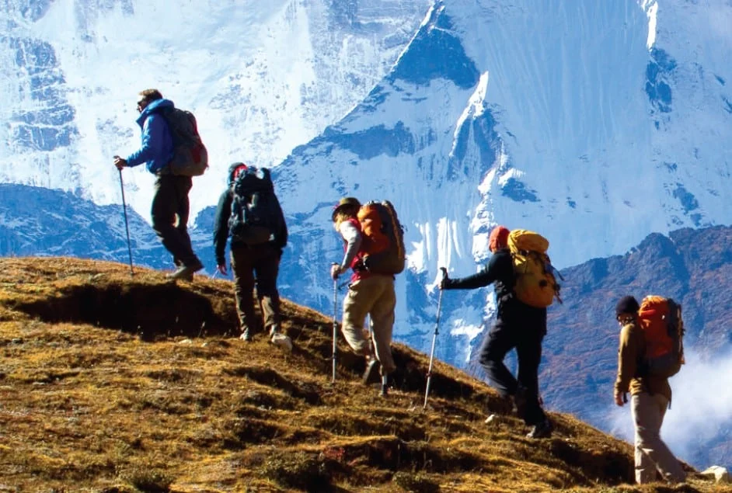
REAL LIFE LAB (RLL) PROJECT
GROUP
4
PROJECT NAME : iMyTravel App
Presented By :
1. Naravula Tagore (2584053)
2. Navyashree D M (2584007)
3. Prateek Tiwari (2583052)
4. Preethi S (2583243)
5. Prerana S (2583167)
6. Rohan R Patil (2582792)
7. Sarvesh Yadav (2583226)
8. Shaik Abdul Wahid (2582125)

Slide 2
CONTENTS
Title
Contents
Modules
Objective
Introduction
Database schema
Admin and user components
Software requirements
Imytravel app
Testing reports
Conclusion
Thank you

Slide 3
MODULES
Name | Domain | Modules
1. Naravula Tagore | FSD User | Sign Up
2. NavyaShree D M | FSD Admin/User | Welcome Page & Reset Password
3. Prateek Diwari | FSD User | Place Suggestion & Comment
4. Preethi S | FSD User | Admin Dashboard, Edit Tour
5.Prerana S | FSD User | Sign In
6. Rohan Patil | FSD User | User Dashboard & User Booking
7. Sarvesh Yadav | FSD User | Book Tour & Add Tour
8. Shaik Abdul Wahid | FSD Admin/User | User Profile

Slide 4

OBJECTIVE
Comfortable for users
User-friendly
Flexible
Informative

Slide 5

INTRODUCTION
iMyTravel App has two parts
i.Admin
ii.User
The Admin Section is like the control hub of our Application, giving users to explore the experiences of others.
Users can create personalized accounts, conveniently review, and explore the other users experiences with detailed descriptions, cost , climate and etc.

Slide 6
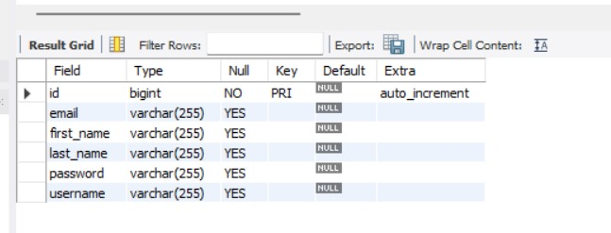
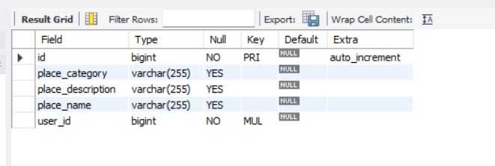
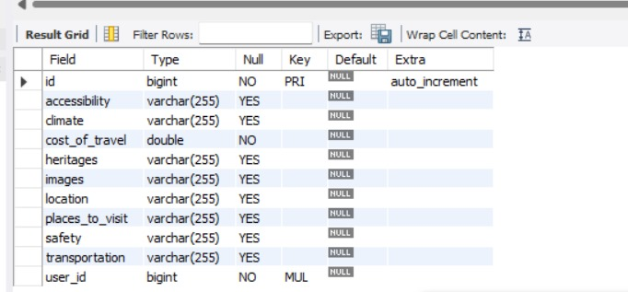
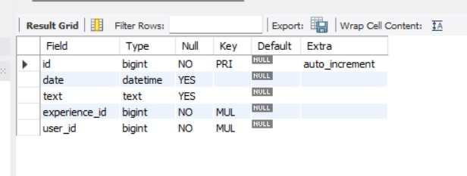
DATABASE SCHEMA
User
Place_Suggestion
Travel_Experience
Comments

Slide 7
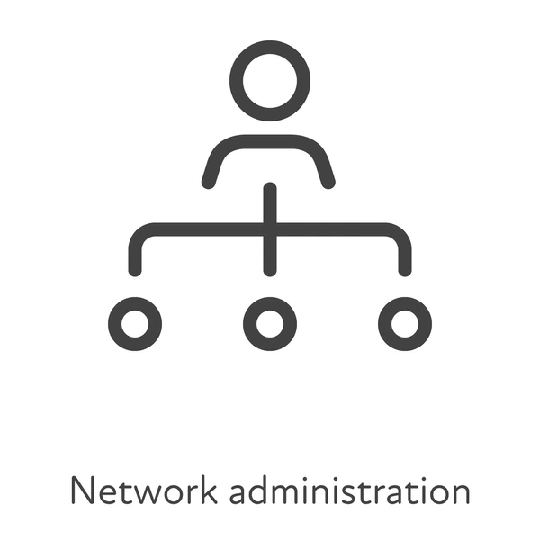
ADMIN AND USER COMPONENTS

Slide 8
ADMIN COMPONENTS
Welcome page
Admin dashboard
Admin Registration
Admin login
Reset Password
Edit user comments
Add comments

Slide 9
USER COMPONENTS
User dashboard
User register
User login
Reset Password
User profile
Place suggestions
Travel Experiences
Comments

Slide 10





Database: MySql Workbench Back-end: Spring Boot Suite Tool Front-End: Angular With VS-Code Testing: Postman Tool, Selenium Test Ng
SOFTWARE REQUIREMENTS

Slide 11
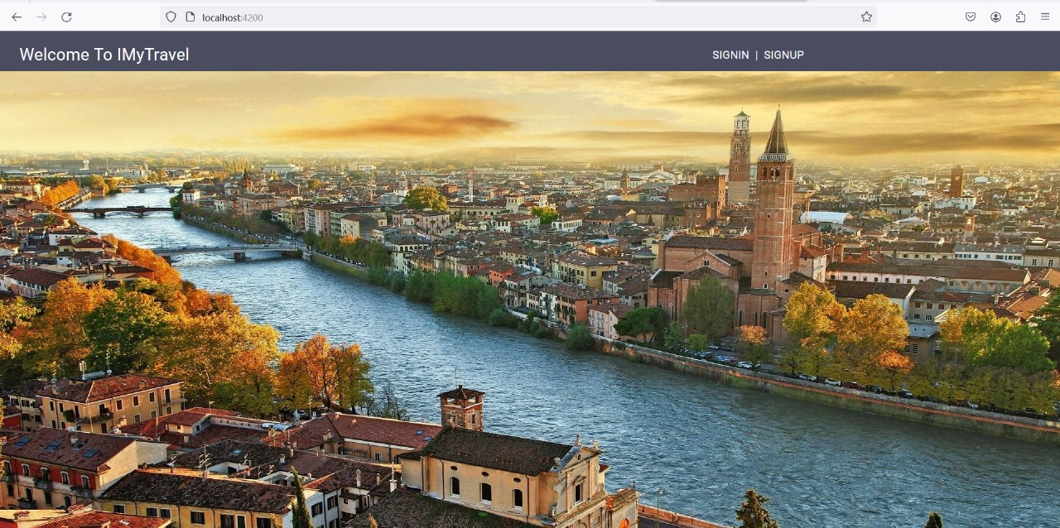
At welcome page we can access sign in and sign up Pages.
WELCOME PAGE

Slide 12
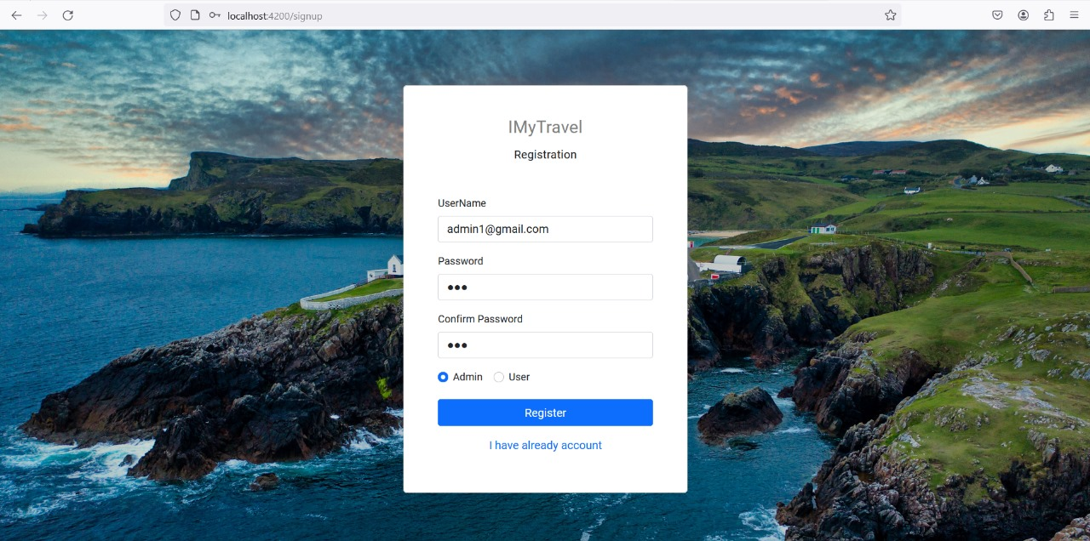
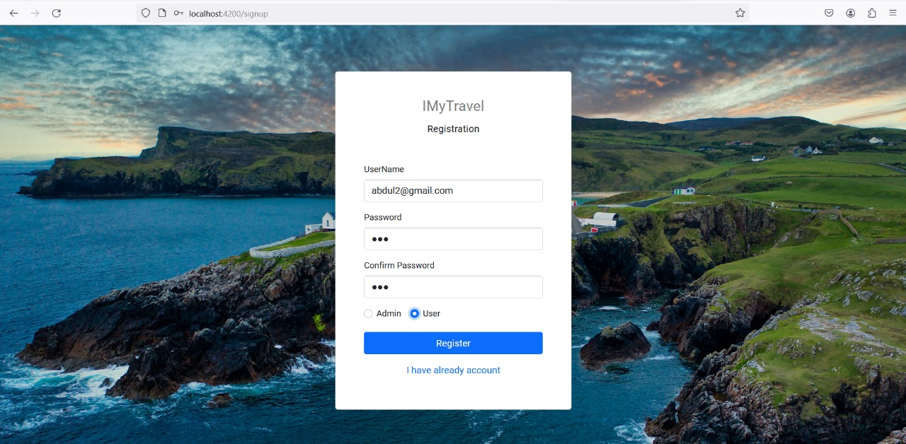
SIGN UP
In sign-up page the admin and users can able to register their profile by giving the user name and password.
If you want to enter into profile we need to create profile for admin/user.

Slide 13
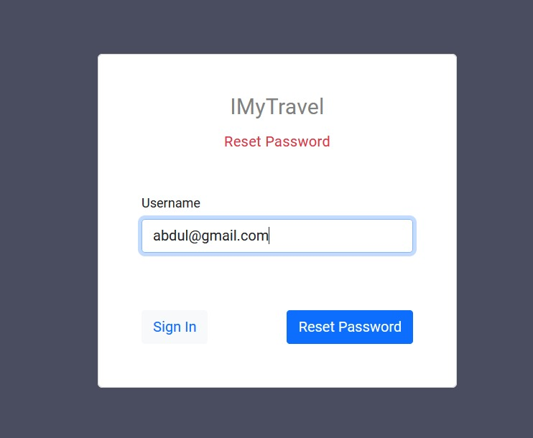
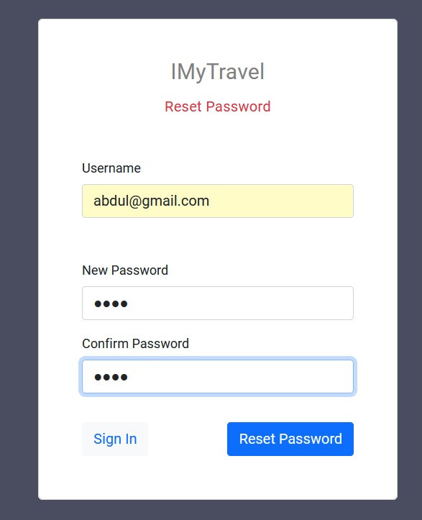
RESET PASSWORD
In reset password module the user and admin can reset the password by using their user name.
In Rest Page, the user & admin can give their email address for resetting password

Slide 14
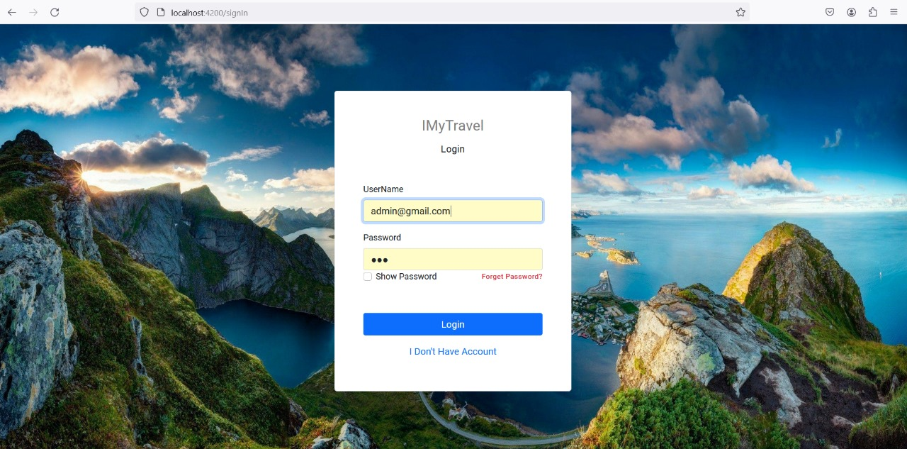
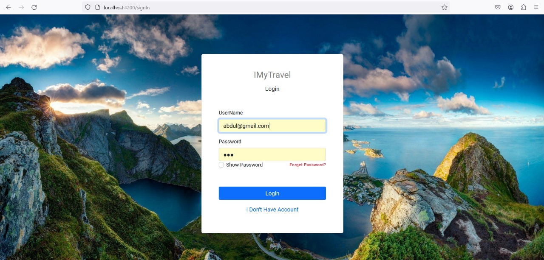
SIGN IN
In this page the admin and user can able to login to their profile using their credentials.
If the credentials doesn’t match then it shows an error.

Slide 15
ADMIN LOGIN
Admin login is to validate admin credentials.
If credentials are matched, it will redirect to Admin dashboard
If we enter wrong credentials system will give message invalid credentials.

Slide 16
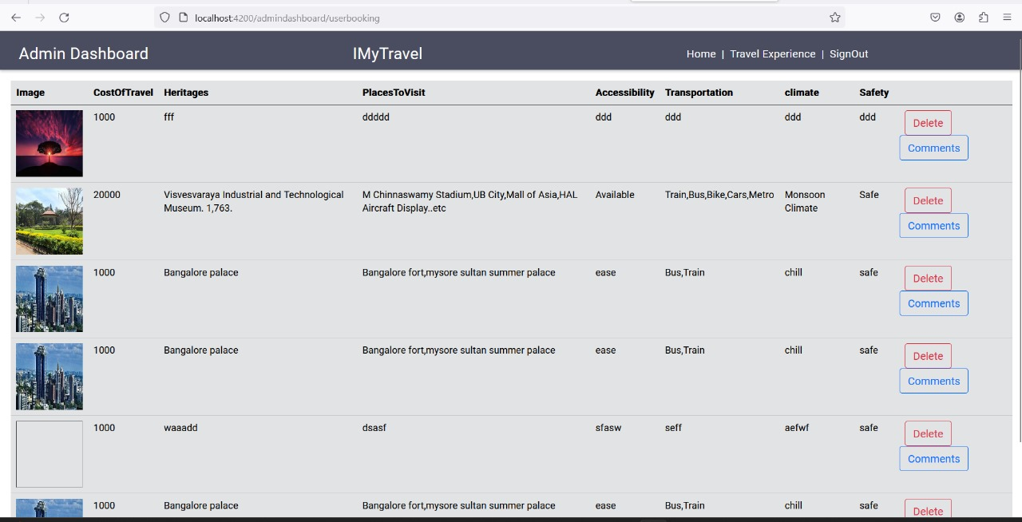
In this page admin can see all users added details like image, cost of travel ,Heritages ,Place to visit , Accessibility ,Transportation etc Also Admin can delete place detail also edit the comments
Admin Dashboard

Slide 17
USER LOGIN
Here, The user first want’s to log-in and then go for the User Dashboard.

Slide 18
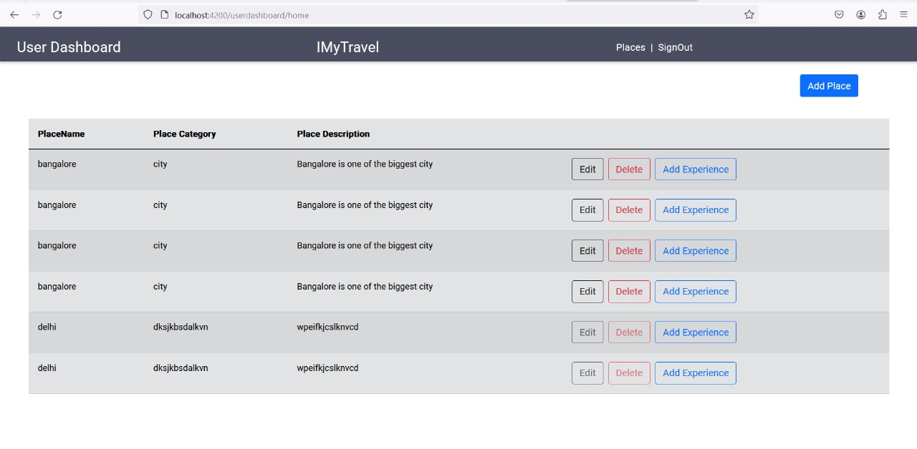
USER DASHBOARD
On successful User login, redirected to User homepage/Dashboard.
In that page the user can able to add their travelled place and place category by clicking Places button. User also can able to sign out by clicking Sign out button

Slide 19
USER HOME
Input fields for place name, Place Category and description.
Options to Edit, Delete, or Add experience of each place.

Slide 20
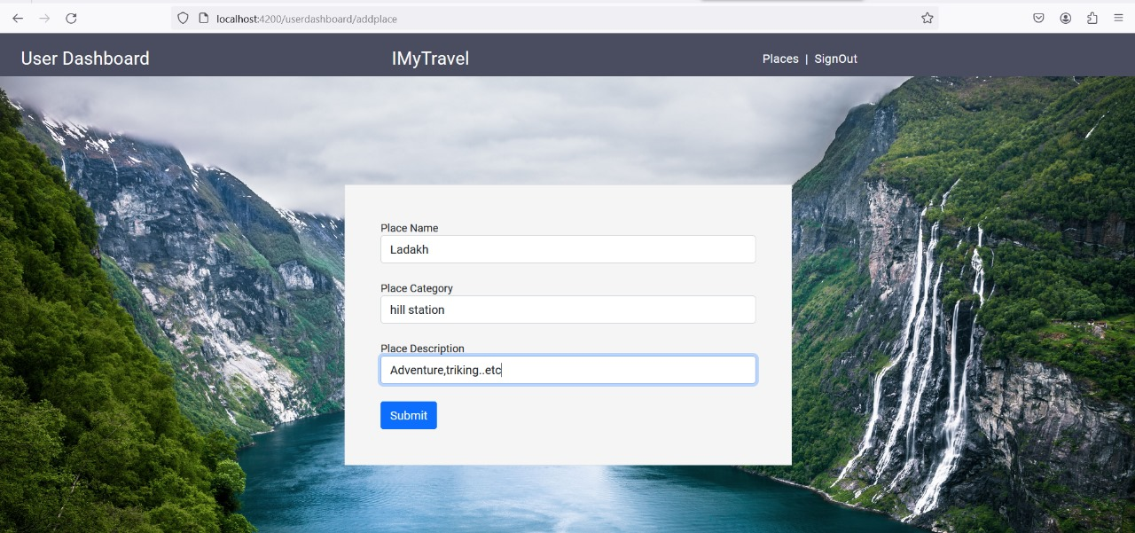
PLACE SUGGESTION
If the user can travel the world anywhere and he can choose the place suggestion in this place suggestion.
By the user references the others can see the suggestion places to visit and then go to that places.

Slide 21
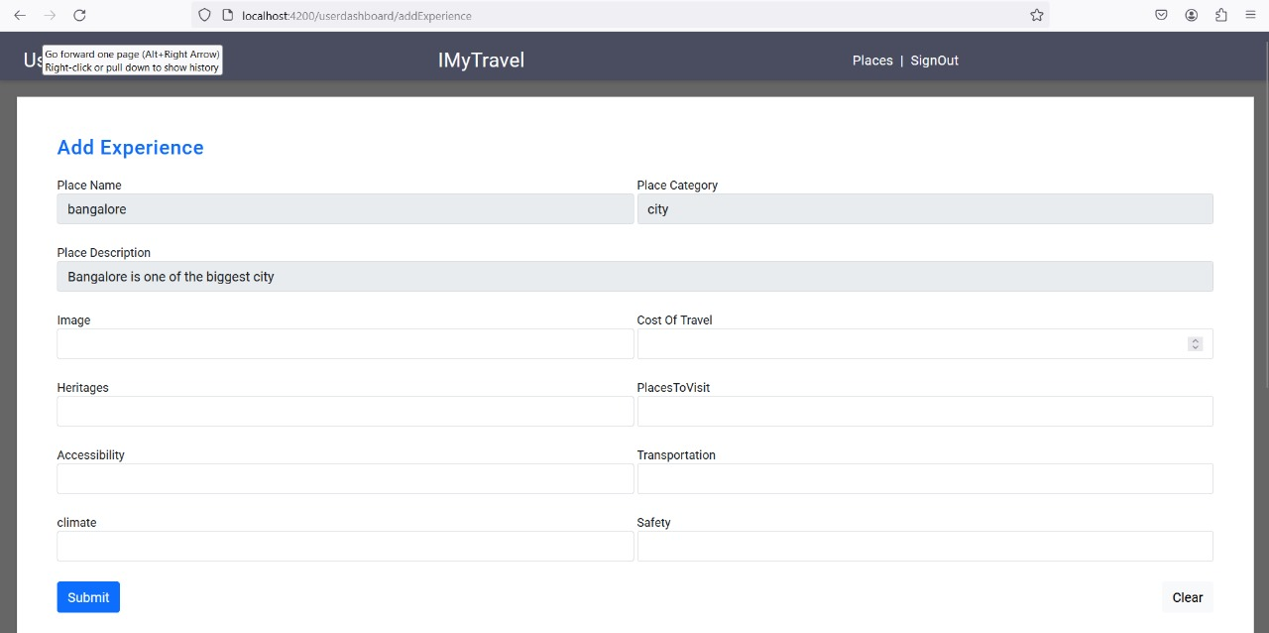
Add Experience
The User can explore their Travel Experience.
User Can Add the Cost Of travel And Add the travelling pictures and Some near places to visit.

Slide 22
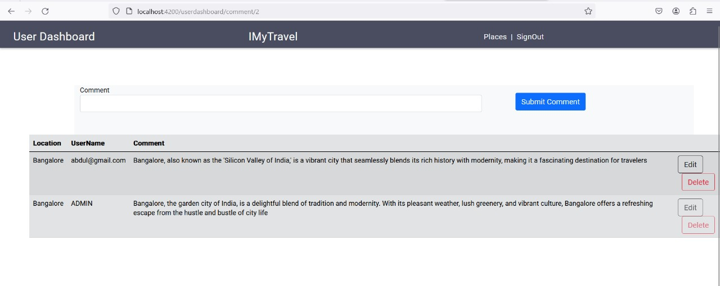
In this Comment module, the admin and user can able to add their own comments. In this Comment page user & admin can share thetheirexperiences in comments.
comment

Slide 23
ADD COMMENT
In this add comment page the users should able to add their comments.
In that comment, they can add the places which they visited and they also add place suggestions to other users.

Slide 24
EDIT COMMENT
In this edit comment page the admin& user can edit and delete comment of the users.
If users commenting with mistakes the admin & user should able to edit it.
If users commenting something bad the admin have the right to delete the comment.

Slide 25

POSTMAN TESTING REPORTS

Slide 26
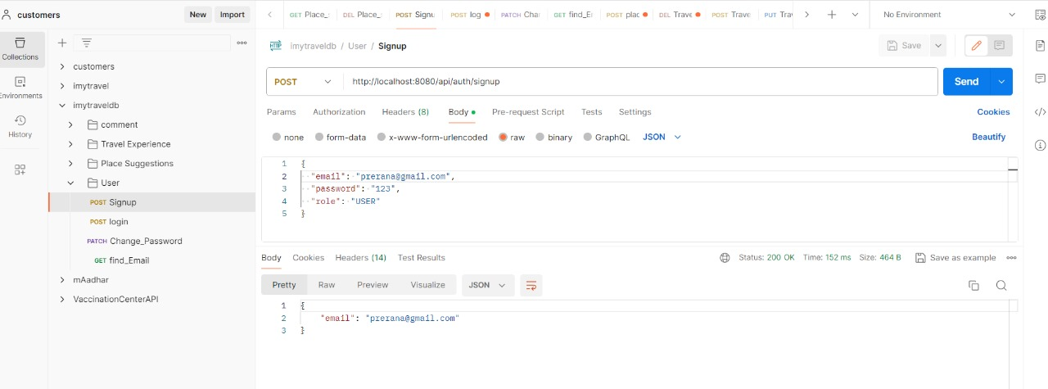
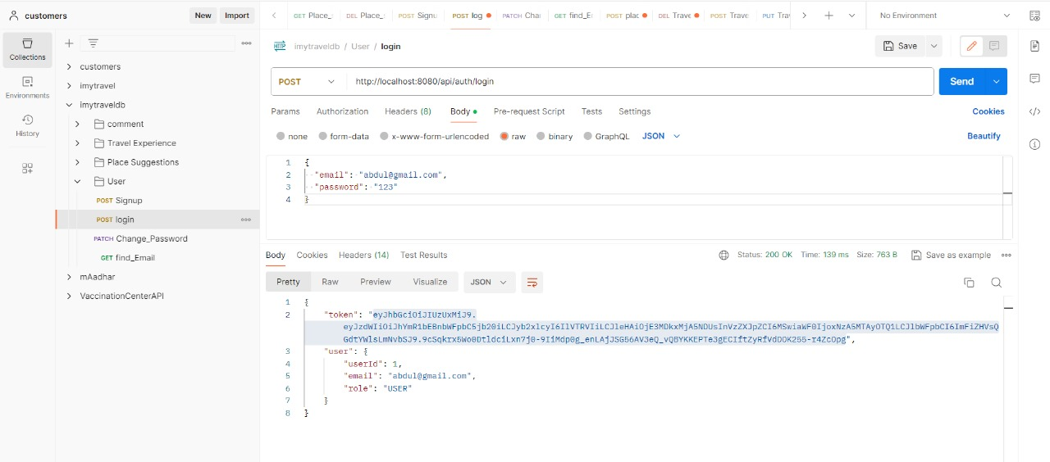
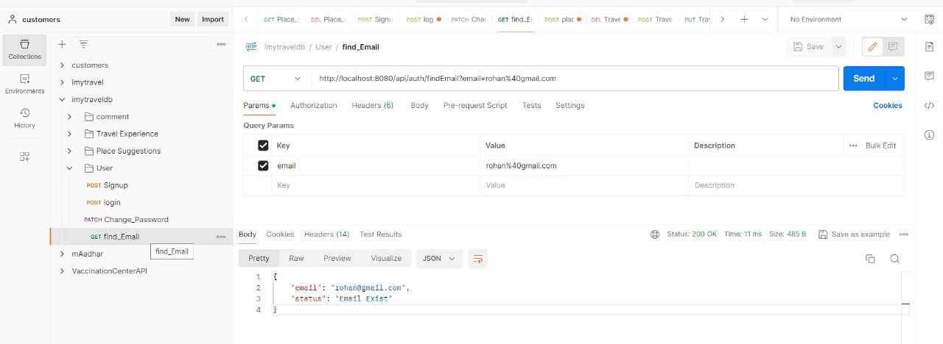
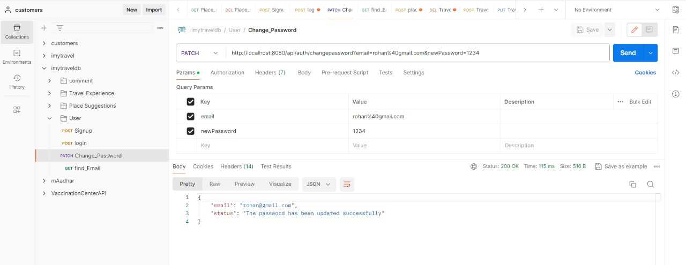
USER

Slide 27
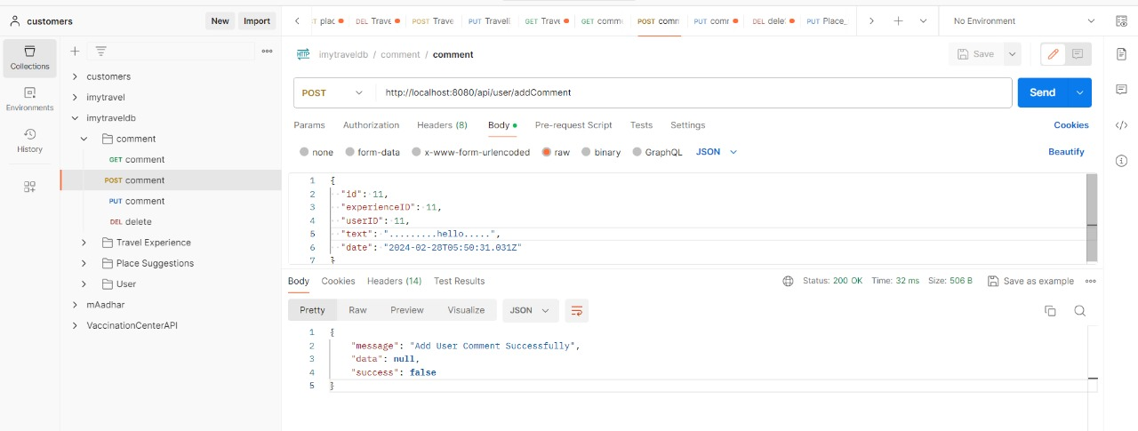
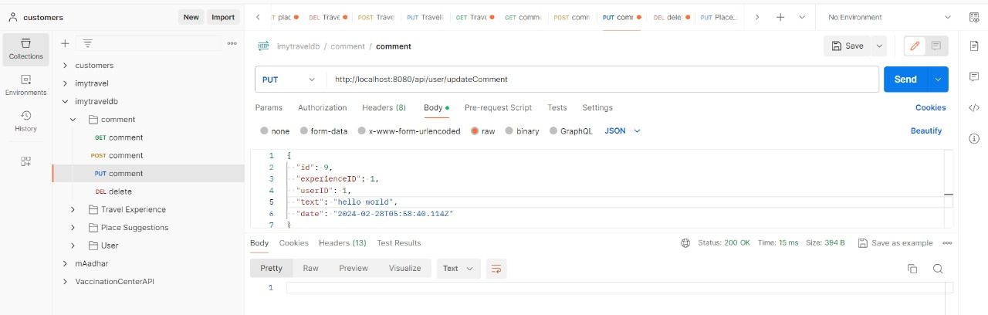
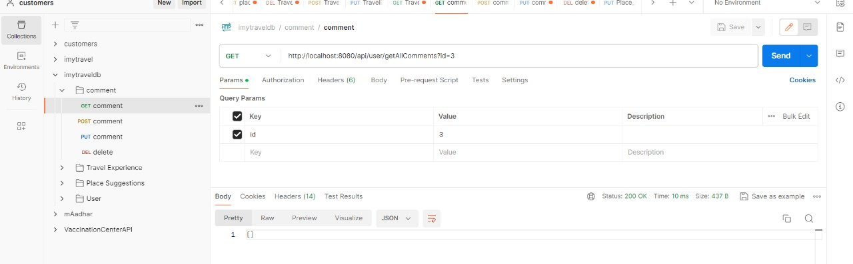
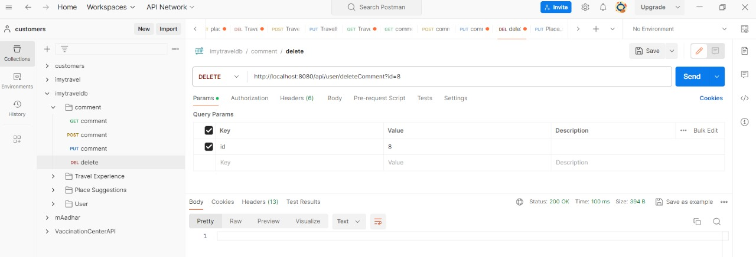
COMMENTS

Slide 28
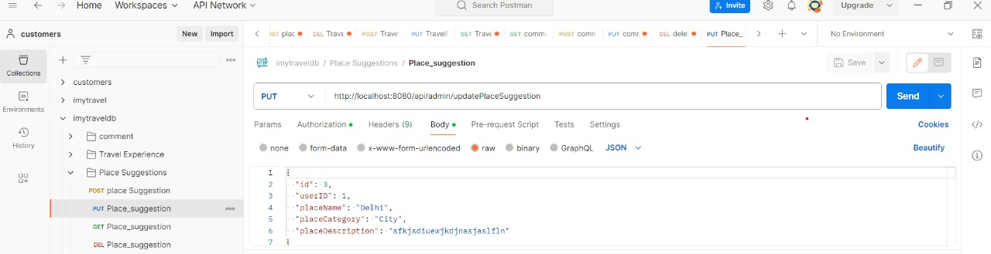
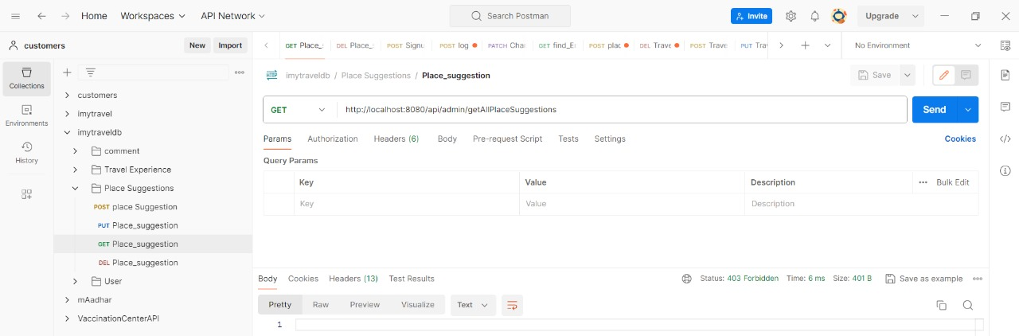
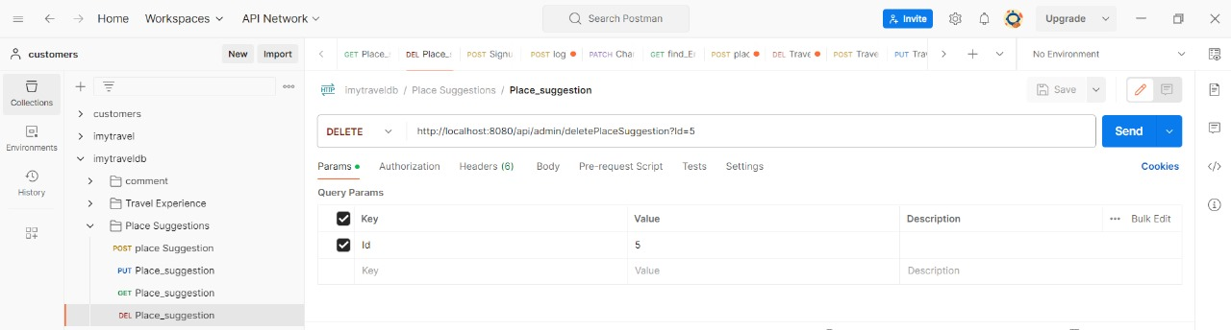
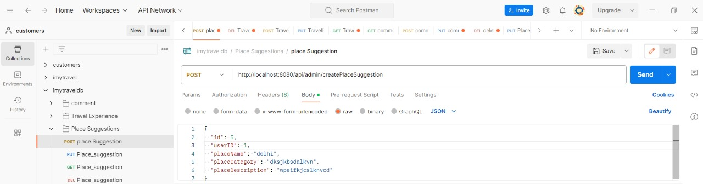
PLACE SUGGESTIONS

Slide 29
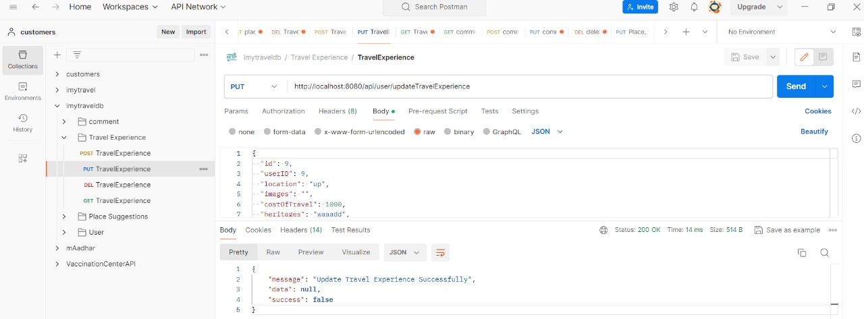
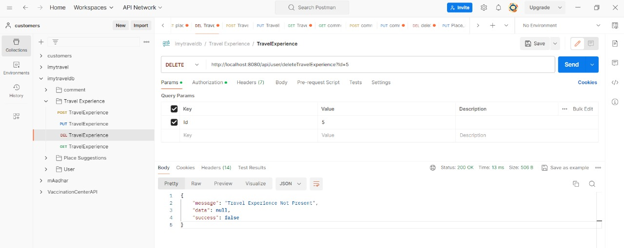
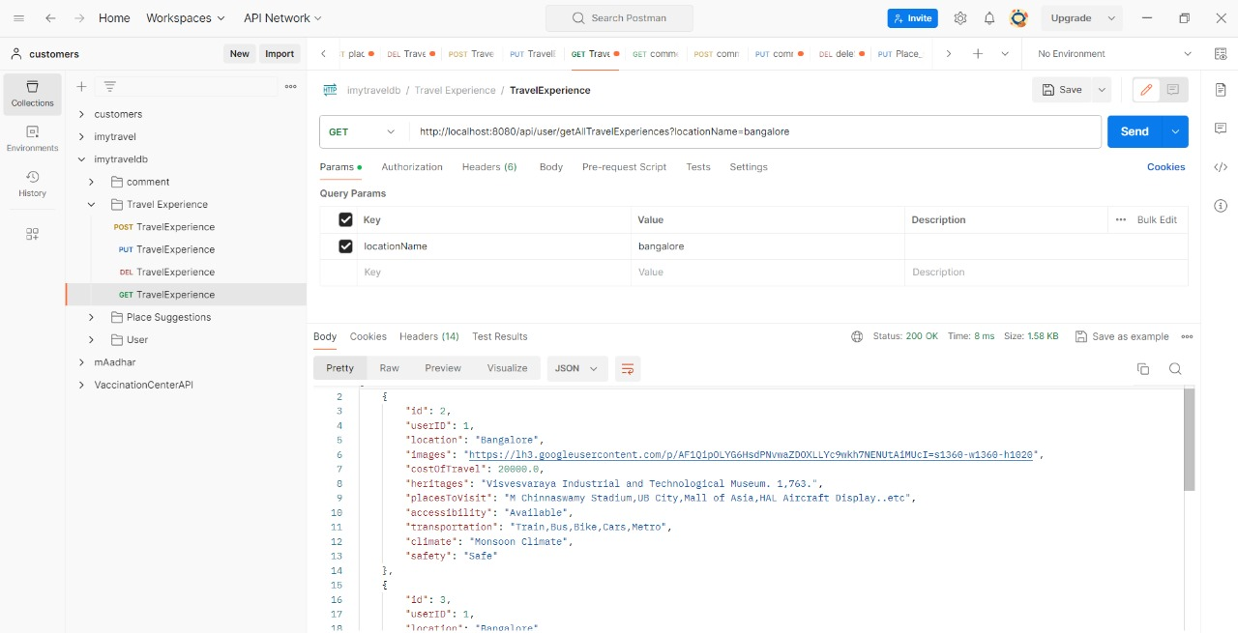
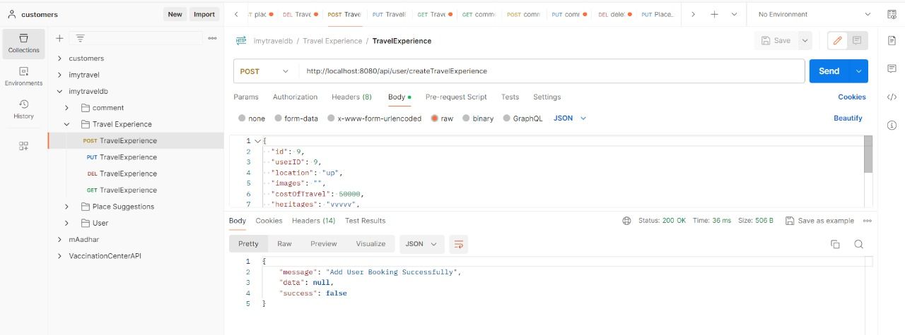
TRAVEL EXPERIENCES

Slide 30

TESTING REPORTS

Slide 31
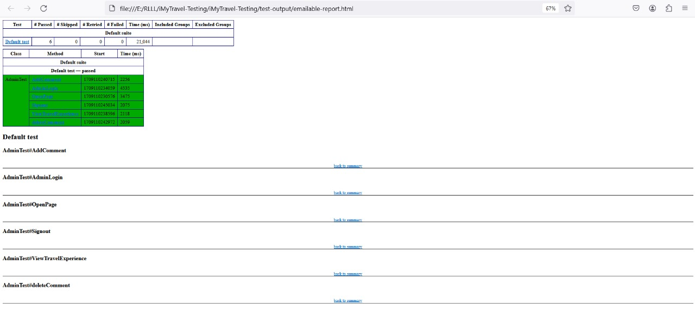
ADMIN TEST EMAILABLE REPORT
In this admin test
We have taken report from emailable-report.hmtl page to see how the test cases pass and fail.

Slide 32
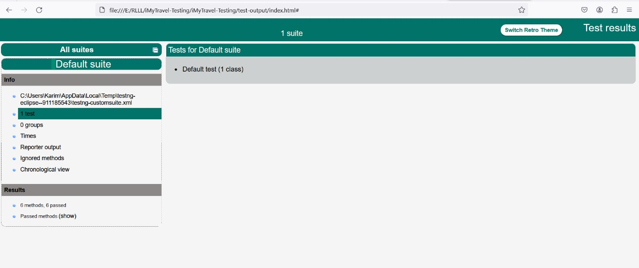
ADMIN TEST INDEX
In this admin test
We have taken report from index.hmtl page to see how the test cases pass and fail.

Slide 33
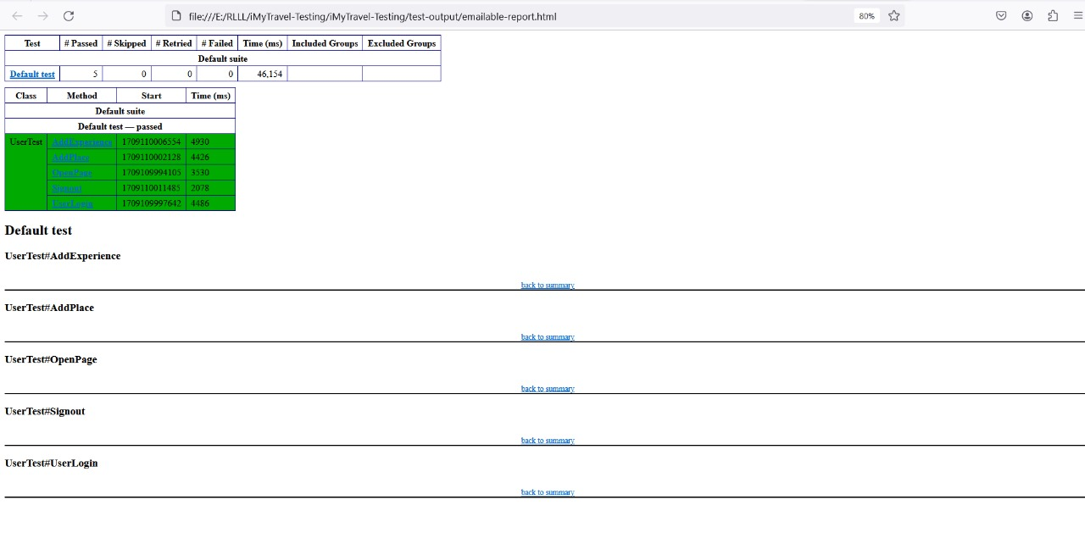
USER EMAILABLE TEST REPORT

Slide 34
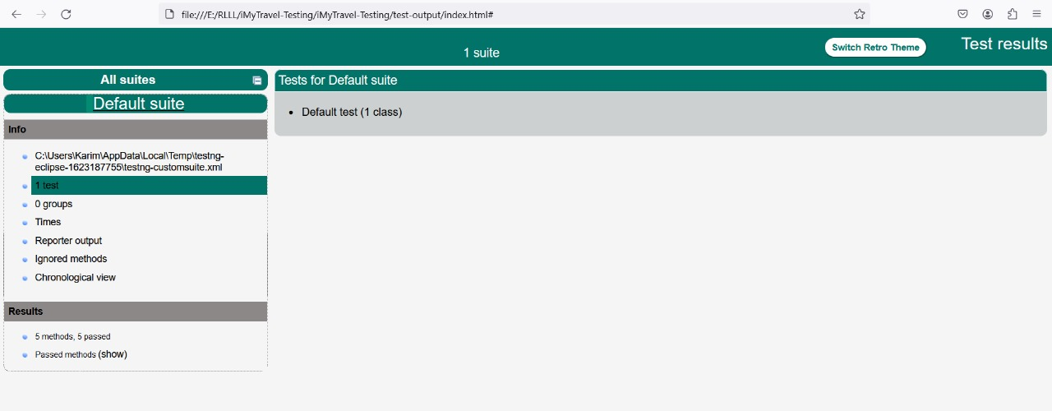
USER TEST INDEX

Slide 35
CONCLUSION
The iMyTravel Application, consisting of both the User and Admin sections.
Admin section provides a travel experiences , comments and place suggestions of the users and admin can add their own travel experiences.
The User section allows individuals to create personalized accounts, add their own travel experiences, comments of the places which they visited and explore other users experiences.

Slide 36
THANK YOU !

